Slide 1
Entity-Relationship Model
Database Management Systems
Sunzid Hassan

Slide 2
Outline
• Database Requirements
• Entity and Attribute
• Relationships
• ER Diagram

Slide 3
Requirements
• The company is organized into departments. Each department has unique name, and a particular employee who manages the department. A department may have several locations.
• A department controls a number of projects, each of which has a unique name, and a start date.
• The database will store each employee’s name, social security number, salary, and birth date. An employee is assigned to one department, but may work on several projects, which are not necessarily controlled by the same department.

Slide 4
Example Database
Emp._ SSN | First_ Name | Last_ Name | Salary | Birth_ Date | Dept. | Dept.-Mngr._ SSN | Address | Project
01…23 | Jane | Doe | 60,000 | 01-01-1990 | Finance | 01…23 | … | Annual Report
01…34 | Wade | Wilson | 50,000 | 11-22-1973 | Finance | 01…23 | … | Annual Report

Slide 5
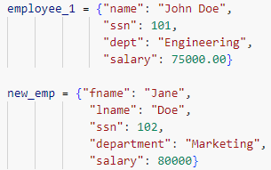
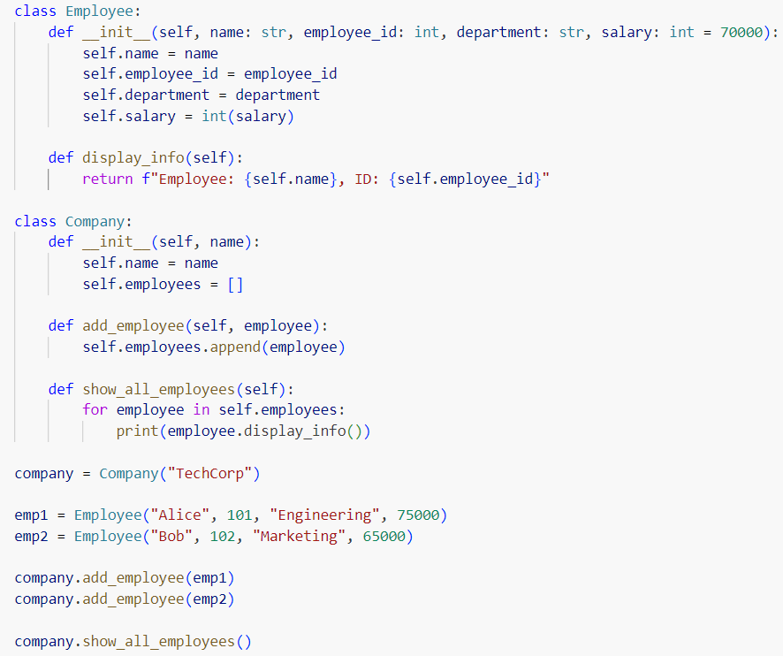
Factoring

Slide 6
Example Database
EMPLOYEE
DEPARTMENT
PROJECT
Emp._ SSN | First_ Name | Last_ Name | Salary | Birth_ Date | Dept. | Dept.-Mngr._SSN | Addre-ss | Project
01…23 | Jane | Doe | 60,000 | 01-01-1990 | Finance | 01…12 | … | Annual Report
01…34 | Wade | Wilson | 50,000 | 11-22-1973 | Finance | 01…23 | … | Annual Report

Slide 7
Entity and Attribute
Emp._ SSN | First_ Name | Last_ Name | Salary | Birth_ Date | Emp._ SSN | Dept. | Project
01…23 | Jane | Doe | 60,000 | 01-01-1990 | 01…23 | Finance | Annual Report
01…34 | Wade | Wilson | 50,000 | 11-22-1973 | 01…34 | Finance | Annual Report
Dept. | Dept.-Mngr._SSN | Address
Finance | 01…12 | …
Project | Controlling_ department | Start_date
Annual Report | Finance | 01-01-2025

Slide 8
Entity and Attribute
Entity: Concept or object of the mini-world, represented in the database.
• EMPLOYEE John Doe, Research DEPARTMENT, ProjectX PROJECT.
Attribute: Properties that describes an entity.
• Name, SSN, salary of an EMPLOYEE.
• Each attribute has a specific value set.
Name – character string of up to 15 characters.
SSN – list of nine integers.

Slide 9
Attribute Types
Simple: each entity has a single atomic value of the attribute.
• SSN
Composite: divided into smaller subparts.
• Name {First_Name, Last_Name}
• Address {Apt#, House#, Street, City, State, ZipCode, Country}
Multi-valued: multiple values for an attribute.
• Projects of a DEPARTMENT.
Derived
• Number of employees in a DEPARTMENT.

Slide 10
ER Diagram
LName
Manager
SSN
Salary
Dept.
FName
SSN
Name
Address
Name
Employee
BDate
Department
Total_emp.
Controlling Department
Name
Start Date
Project

Slide 11
Querying
What about manager name??
Manager
SSN
LName
Salary
Dept.
FName
SSN
Name
Address
Name
Employee
BDate
Department
Total_emp.
Controlling Department
Name
Start Date
Project

Slide 12
Key Attributes
Each entity type must have a key attribute*.
•Key attribute.
One or more attributes whose values are distinct for each individual entity in the entity set.
Ex.: SSN of EMPLOYEE.
•Key attribute may be composite.
Registration - key of CAR entity type composed of (Number, State).
•Entity type may have more than one key.
Ex.: CAR entity type has two keys:
VehicleIdentificationNumber - VIN numbers.
VehicleTagNumber (Number, State) - license plate number.
•Key attribute of an entity type must follow uniqueness property for every entity in a set.

Slide 13
Key Attributes
LName
Manager
SSN
Salary
Dept.
FName
SSN
Name
Address
Name
Employee
BDate
Department
Controlling Department
Proj_ID
Key??
Name
Start Date
Project

Slide 14
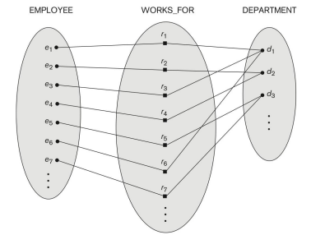
Relationship
Relationship relates two or more distinct entities with a specific meaning.
Relationship type defines a collection of relationship among entities from entity types.

Slide 15
Relationships as Attributes
•WORKS_FOR relationship between EMPLOYEE and DEPARTMENT entity types can be expressed as an attribute:
Attribute Department of EMPLOYEE entity type.
References to the DEPARTMENT entity for which employee works.
Values – set of all DEPARTMENT entities (entity set).
Multi-valued attribute Employees of DEPARTMENT entity type.
Reference to the EMPLOYEE entities that work for a department.
Values – set of all EMPLOYEE entities who work for that department.
•Either of attributes (Department of EMPLOYEE / Employee of DEPARTMENT) can represent WORKS_FOR relationship type.

Slide 16
Relationships as Attributes
LName
Manager
SSN
Salary
Dept.
FName
SSN
Name
Address
Name
Employee
BDate
Department
Controlling Department
Proj_ID
Key??
Name
Start Date
Project

Slide 17
ER Diagram
Salary
WORKS_ FOR
Total_emp.
Name
LName
SSN
FName
Start_date
Address
Name
EMPLOYEE
DEPARTMENT
MANAGES
BDate
CONTROLS
PROJECT
Name
Proj_ID
Start Date
1

Slide 18
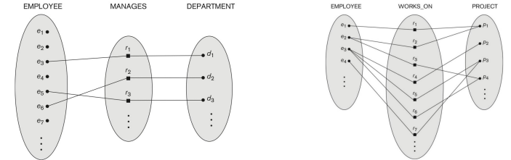
Cardinality Ratio Constraint
Cardinality ratio.
Specifies maximum number of relationship instances that an entity can participate in.
One-to-one (1:1).
One-to-many (1:N) or many-to-one (N:1).
Many-to-many (M:N).
Represented as 1, M, or N on the diamonds in ER diagram.

Slide 19
Participation constraint
•Participation constraint (existence dependency).
Specifies minimum number of relationship instances that an entity can participate in.
Participation can be total or partial.
Total is mandatory participation.
Displayed as a double line connecting the participating entity type to the relationship in ER diagram.
Partial is optional participation.
Displayed as a single line connecting the participating entity type to the relationship in ER diagram.

Slide 20
ER Diagram
N
1
Name
Salary
WORKS_ FOR
LName
SSN
Total_emp.
FName
Start_date
Address
Name
EMPLOYEE
1
1
DEPARTMENT
MANAGES
BDate
1
CONTROLS
N
PROJECT
Name
Proj_ID
Start Date
1

Slide 21
Summary
ER model basic concepts.
Entity
Attributes
Types
Key attribtes
Relationship
Relationship types.
Relationship constraints.

